Slide 1
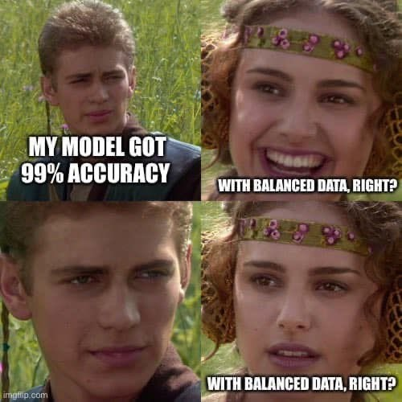

Slide 2
Warm Up
Type in chat:
How can we be certain our models will perform well in the real world with new data?

Slide 3
Announcements
Belt Exam for Stack 2
March 11th - March 13th
Must have attended 80% of classes
Must have passed 90% of assignments
All assignments & resubmits from weeks 1 & 2 are due by Friday at 9am PST (March 11th)
Week 3 Assignments
Highly encourage you to finish these before the belt exam.
Project 2 - Final
Still in the process of grading this assignment

Slide 4
Tips and Tricks
CopyPasta
Copy/Pasting Code:
Hurts your learning
Slower coder
Less code understanding
Unprepared for technical interviews
Causes errors:
Most common source of serious errors
Code looks amateur
Challenge
I challenge you to type all code for the rest of this program. (no copying and pasting)

Slide 5
Tips and Tricks
Project 2, part 1: Choosing Data
Look for data that:
Has a target column to predict.
With a target that is likely predictable using available features.
Is not overly complex or overly simple.
6-15 columns that you mostly understand and can explain
1000-100,000 rows with not too much missing data (less than 10%)
Is something you are interested in.
Be ready to answer the question: Why did this project interest you?
Try Googling ‘datasets for machine learning’ and look through articles, sources, lists, repositories.

Slide 6
Learning Goals
At the end of this class you will be able to:
Know how a KNN model classifies a new data point
Read a confusion matrix to understand what kinds of mistakes your model is making
Determine which classification metric is most important for a given business problem
Evaluate a classification model in sklearn

Slide 7
Classification Models

Slide 8
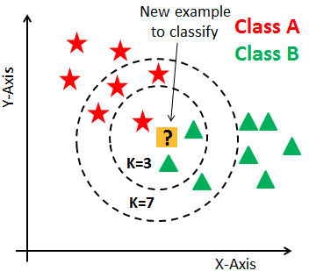
K-Nearest Neighbors (KNN)
You decide the K number of neighbors
Regularization: Adjust K

Slide 9
Classification Evaluation Metrics
Accuracy
Precision
Recall (Sensitivity)
Specificity
F1 Score

Slide 10
Classification Evaluation Metrics
Binary Classification:
Predict 1 of 2 classes, positive (1) or negative (0)
Multiclass Classification
Predict 1 of 3 or more classes.

Slide 11
Classification Evaluation Metrics
We are going to start with
Binary Classification Metrics

Slide 12
The Confusion Matrix:
A more complete story

Slide 13
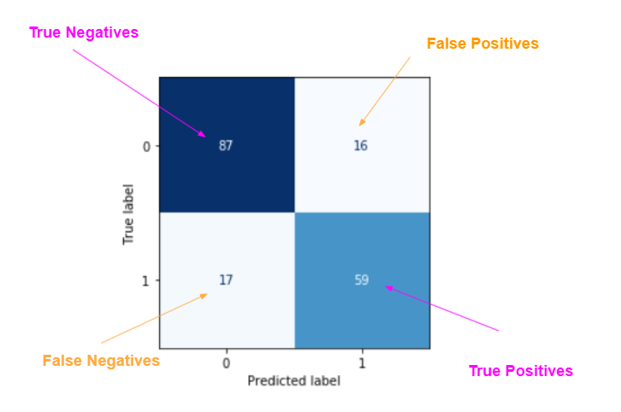
Let’s look at this example of a confusion matrix (this is also in the learn platform)
To help us understand the terminology and calculations in classification metrics.

Slide 14
Accuracy
The percent of correct choices out of the total number of predictions
Accuracy
True Positives + True Negatives
All Predictions

Slide 15
Accuracy
Pros:
One number describes all classes
Easy to interpret
Works the same with binary or multiclass

Slide 16
Accuracy
Pros:
One number describes all classes
Easy to interpret
Works the same with binary or multiclass
Cons:
Does not tell the whole story
Can be misleading when classes not balanced

Slide 17
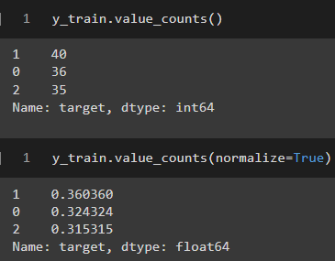
Accuracy Depends on Class Balance

Slide 18
Test Set
Prediction
0
0
0
0
0
0
0
0
0
0
A simple baseline model predicts 0 for every row in the test set

Slide 19
Test Set
Prediction | Actual
0 | 0
0 | 0
0 | 0
0 | 0
0 | 0
0 | 1
0 | 0
0 | 0
0 | 0
0 | 0
How did our baseline do?
The baseline got 9 out of 10 correct.
That is an accuracy of 90%!!!

Slide 20
While it is tempting to be excited about an overall accuracy of 90%, we didn’t really achieve anything with our baseline!
If we were trying to identify people who had a disease, we failed!

Slide 21
While it is tempting to be excited about an overall accuracy of 90%, we didn’t really achieve anything with our baseline!
If we were trying to identify people who had a disease, we failed!
If we were trying to identify spam emails, we failed!

Slide 22
While it is tempting to be excited about an overall accuracy of 90%, we didn’t really achieve anything with our baseline!
If we were trying to identify people who had a disease, we failed!
If we were trying to identify spam emails, we failed!
If we were trying to identify fraudulent credit card purchases, we failed!
There is more to evaluating a classification model than just accuracy!
And there is absolutely more to making predictions than just our baseline!

Slide 23
Recall: (Also called “Sensitivity”)
Is our model able to identify the positive cases?
Recall
True Positives
True Positives + False Negatives

Slide 24
Recall: (Also called “Sensitivity”)
Is our model able to identify the positive cases?
Pros:
Minimizes False Negatives: good at finding positive class
Tells a piece of the story

Slide 25
Recall: (Also called “Sensitivity”)
Is our model able to identify the positive cases?
Pros:
Minimizes False Negatives: good at finding positive class
Tells a piece of the story
Cons:
Does not penalize false positives
Perfect recall can be achieved by over-predicting positives

Slide 26
Test Set
Prediction | Actual
1 | 0
1 | 0
1 | 0
1 | 0
1 | 0
1 | 1
1 | 0
1 | 0
1 | 0
1 | 0
How did this model do?
True Positives = 1
False Negatives = 0
Recall = 1 / 1+0
The model found all of the positive samples.
That is a recall of 100%!!!

Slide 27
Precision (AKA Positive Predictive Value):
Are predicted positives really positive?
Precision
True Positives
True Positives + False Positives

Slide 28
Precision:
Are predicted positives really positive?
Pros:
Minimizes false positives
Prevents over predicting positive class
Tells a piece of the story

Slide 29
Precision:
Are predicted positives really positive?
Pros:
Minimizes false positives
Prevents over predicting positive class
Tells a piece of the story
Cons:
Does not encourage finding positives
Perfect precision can be achieve by predicting all negatives

Slide 30
Test Set
Prediction | Actual
0 | 0
0 | 0
0 | 0
0 | 0
0 | 0
0 | 1
0 | 0
0 | 0
0 | 0
0 | 0
How did our baseline do?
True Positives = 0
False Positives = 0
Precision = 0 / 0+0
(technically undefined)
All predicted positives are positive
That is a precision of 100%!!!

Slide 31
Specificity: (Recall on Negative Class)
Is our model able to identify the negative cases?
Specificity
True Negatives
True Negatives + False Positives

Slide 32
Specificity:
Is our model identifying negatives as negatives?
Our original baseline had perfect specificity because it predicted ALL negatives.
But once again this is not useful!
We don’t want to miss those positive cases! (disease, spam, fraud)
Pros and Cons are Similar to Precision

Slide 33
Test Set
Prediction | Actual
0 | 0
0 | 0
0 | 0
0 | 0
0 | 0
0 | 1
0 | 0
0 | 0
0 | 0
0 | 0
How did our baseline do?
The baseline successfully found all negative samples
True negatives = 9
False positives = 0
9 / 9 + 0 = 1!
That is an specificity of 100%!!!

Slide 34
F1 Score:
Is our model finding a balance of positives and negatives?
TNR (True Negative Rate)
=
Precision * Recall
Precision + Recall
2 *
Balances Precision and Recall

Slide 35
F1 Score:
Are precision and recall both good?
Pros:
Gives a more complete picture
Minimizes false positives AND false negatives

Slide 36
F1 Score:
Are precision and recall both good?
Pros:
Gives a more complete picture
Minimizes false positives AND false negatives
Cons:
Hard to interpret
Hard to explain, especially to non-data scientists.
Not good for presentations

Slide 37
Classification Metrics Summary
Accuracy
Use when you have balanced data and you want to find out how many predictions were correct. Good for non-technical audiences.
Recall/Sensitivity
Use recall when you want to evaluate the rate of false positives.
e.g. Good to use with cases such as a cancer diagnosis
Precision
Use precision when the cost of acting on a false positive is really high.
e.g. Allocating resources/interventions for prisoners who are at risk for being a reoffender.
Specificity
This is recall on the negative class. Use specificity when you want to evaluate the rate of false negatives.
F1 Score
Most informative about overall model quality, but is the most difficult to express to a non-technical audience.

Slide 38
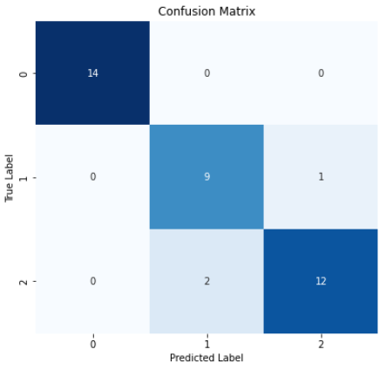
Multiclass Classification Metrics:
Positive class must be defined to calculate Recall, Precision, Sensitivity, and F1 Score
False predictions are any prediction other than true predictions
Can require interpreting metrics on multiple classes to get a complete picture of model behavior.

Slide 39

Classification Metrics in Python:
Remember that defining an average or a positive class is necessary for multiclass problems

Slide 40
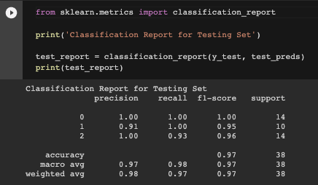
Use a print() statement to make classification_report look nice!
Classification Report
All Metrics on All Classes
Number of observations
In each class.
Classes
Accuracy
Averages for Each Metric

Slide 41
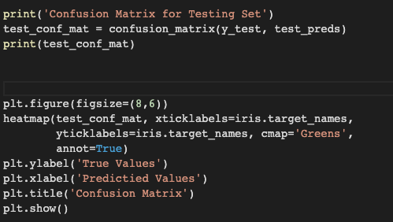
Confusion Matrix

Slide 42
Put it into code!
CodeAlong Notebook!
Data

Slide 43
Challenge Notebook
Practice

